Slide 1
Section Ⅳ Express Your Idea
New Concept

Slide 2
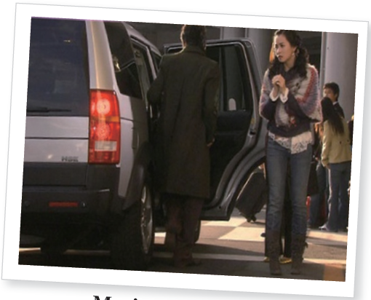


Slide 3

Speak Out
Discuss with your partner about the influence of micro blogs on organizations and individuals after reading the passage . And the following points may be helpful for your discussion.
a. Being popular on a micro blog site is directly related to your number of followers.
b. Government is getting in on the trend of having active micro blog accounts for
the purpose of monitoring what is being said.
c. The micro blog is active engagement with potential customers. With the nearly
half a billion Internet users in China, if a business can capture even a fraction of
a percent of these users via online marketing , the possible profits can be substantial.

Slide 4

Writing
意义替换

Slide 5
Unit 6
Task Practice what you learnt
Fill in the blanks of the following sentences with the proper form of the words given.

Slide 6
Unit 6
Task Practice what you learnt
(1)Fill in the blanks of the following sentences with the proper form of the words given.
1. The books helped _________ the boredom of waiting.(relieve)
2. Local authorities have to _____________ the problems of homelessness.(cope with)
3. How the ____________ is resolved is crucial .(issue)
relieve
Click me
Click me
cope with
issue
Click me

Slide 7
Unit 6
emphasizes
4. The report ____________ the importance of improving safety standards.(emphasis)
5. You can‘t __________ the fact that many criminals never go to prison.（ignorance）
6. Chemicals that are _____________ to the environment(harm)
7. The drug has a(n)________ effect on the immune system.(benefit)
Click me
Click me
ignore
Click me
harmful
Click me
beneficial

Slide 8
Unit 6
8. The teacher should try to ____________ the possibility that the child has a hearing defect.(elimination)
9. His actions could __________ him losing his job.(lead to)
10. The explosion _____________ at 5.30 a.m.(occurence)
11. The benefits of the scheme ________ the disadvantages.(outweigh)
eliminate
Click me
Click me
lead to
occurred
Click me
Click me
outweigh

Slide 9
Unit 6
puzzles
12. What ____________ me is why his books are so popular.(puzzle)
13. Sleep disorders are a serious __________ problem. (psychology)
14. We must encourage the planting of new trees and _____________ our existing woodlands.(preserve)
15. Suicide rates have remained ________ unchanged. (essential)
Click me
psychological
Click me
Click me
preserve
essentially
Click me

Slide 10
Unit 6
Click me
16. The government ____________ a ban on the sale of ivory.(impose)
17. Critics __________ that these reforms will lead to a decline in educational standards.(maintain)
18. These talks are_____________ to the future of the peace process.(critics)
19. Dr. Johnson___________ the task of writing a comprehensive English dictionary.(undertake)
imposed
Click me
maintain
critical
Click me
undertook
Click me

Slide 11
Unit 6
20. Parents are under a legal____________ to educate their children. (obligate)
21. I know the mayor really well. __________ , I had dinner with her last week.(fact)
22. The house was surrounded by trees and___________ from the road.(visible)
23. The most ___________ example of an information source is a dictionary.(evident)
Click me
obligation
In fact
Click me
Click me
invisible
evident
Click me

Slide 12
Unit 6
23. The most ___________ example of an information
source is a dictionary.(evident)
24. There is no doubt that the _________ of typhoon was
immense.(influence)
25. I'm afraid we're not making much ______________.
(progressive)
Click me
obvious
Click me
influence
progress
Click me

Slide 13
Unit 6
26. We'd like to know the ___________ why she didn't
accept the job.(reasonable)
27. The hotel is not very modern, but it does have the
_________ of being close to the city center.
(advantageous)
28. ______________ , I'd like to express my thanks to my family.(conclusion)
reason
Click me
Click me
advantage
Click me
To conclude

Slide 14
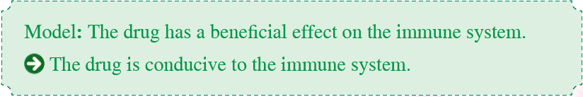
Unit 6
Paraphrase the above sentences and change
the form or sentence structure if necessary.

